Slide 1

Wand Man
By MagiDev

Slide 2
The Dream Team
Bar Ben-zvi – Design Director
Eli Miller – Technical Director
Hunter Starr –Art Director
Nelson Athow - Producer

Slide 3
Art and Audio themes
For our game we have three different areas with different themes:
Area 1: The Underground Cemetery
Area 2: The Living Library
Area 3: The Volcanic Wasteland

Slide 4


Area 1 “The Underground Cemetery.”
The Underground Cemetery is dark and eerie.
The Aural theme for The Underground Cemetery is Eerie and slow.
The Aural theme for the boss fight is moderately faster than the main level, and incorporates glissandos and larger scale hops.

Slide 5


Area 2 “The Living Library”
The Living Library is a place of knowledge and Magic.
The Aural theme of The Living Library is relaxed, chill, and melodic.
The Aural theme of the boss fight is tense, and much faster than the theme of the Main level.

Slide 6
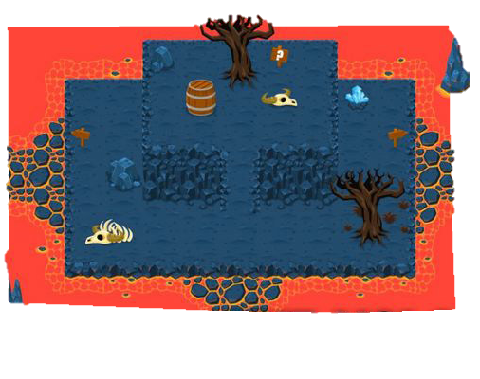

Area 3 “The Volcanic Wasteland”
The Volcanic Wasteland is mysterious and extremely hot.
The Aural theme of The Volcanic Wasteland is slow and ominous, with dissonant notes lending tension to the atmosphere.
The Aural theme of the boss fight music is fast, dramatic, and made frantic by constant involvement of all layers of melody and percussion.

Slide 7
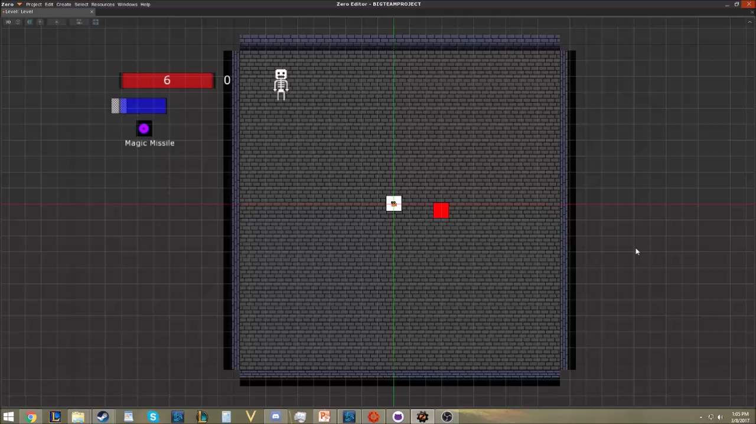
Design Prototype

Slide 8
Core System

Slide 9
Game State Summary
Engine Proof Goals
Goals met
Room system
Player movement
Multiple spell types & spell switching
Multiple bullet movement patterns
Basic enemy shooting
Basic enemy movement/AI
Health
Player fade ability
Basic UI
Room system
Player movement
Multiple spell types & spell switching
Basic enemy shooting
Health
Basic enemy movement/AI
Player fade ability
Basic UI
Limited quantity of Art assets

